Slide 1
Applied Data Science with R Capstone project
REGGINA INDRIANI PUTRI SUWARSONO
12/16/2023

Slide 2

Outline
Executive Summary
Introduction
Methodology
Results
Conclusion
Appendix
2

Slide 3
Executive Summary
Goal:
Examined the impact of weather on bike-sharing demand in urban environments, with a case study of Seoul.
Key Findings:
Weather-Demand Correlation: Strong correlation identified between weather conditions and bike-sharing usage in
Seoul.
Time and Seasonal Influence:
Peak demand during evening hours (17:00 to 21:00).
Summer sees higher bike-sharing demand compared to winter.
Holiday Impact:
Lower bike-sharing demand on holidays, indicating significant use for commuting on workdays.
Effect of Adverse Weather:
Rainy conditions lead to a reduction in bike rentals.
Comparative Analysis:
Observed bike-sharing systems in various Chinese cities including Beijing, Shanghai, Weifang, Ningbo, Xi'an, and Zhuzhou.
Fleet sizes range from 15,000 to 20,000 bicycles, ranked by population size of the city.
3

Slide 4
Introduction
Goal
To analyze how weather would affect bike-sharing demand in urban areas.
Data Sources & Utilization
Seoul Bike Sharing Demand Data
To model the hourly demand for bikes in relation to weather.
Open Weather API Data
For accessing current & forecasted weather.
Global Bike Sharing Systems Data
Information on global bike-sharing programs.
World Cities Data
Geographical data of major cities for contextual analysis.
Project Importance
Gain insights on the dynamic interplay between urban mobility and weather conditions.
Contributes to the optimization of the bike-sharing systems.
4

Slide 5

Methodology
Perform data collection
Perform data wrangling
Perform exploratory data analysis (EDA) using SQL and visualization
Perform predictive analysis using regression models
How to build the baseline model
How to improve the baseline model
Build a R Shiny dashboard app
5

Slide 6
Methodology
6

Slide 7

Data Collection
Web Scraping Global Bike-Sharing
Systems:
Extract and convert data from the Global Bike- Sharing Systems Wikipedia page into raw_bike_sharing_systems.csv.
Retrieve current weather data and a 5-day forecast for multiple cities.
Store the forecast data in
raw_cities_weather_forecast.csv.
OpenWeather API Integration:
Dataset Downloads:
Download and store raw_worldcities.csv and
raw_seoul_bike_sharing.csv from cloud storage.
7

Slide 8
Data Wrangling
Objective
To clean and prepare the collected bike-sharing data for exploratory, visual, and predictive analysis by removing noise and standardizing formats.
Tasks and Processes
Data Standardization with Stringr and Regular Expressions:
Standardize Column Names: Ensure consistency in column naming across all datasets.
Remove Reference Links: Use regular expressions to identify and eliminate undesired reference links from the data.
Extract Numeric Values: Apply regular expressions to extract and isolate numeric values from textual data.
Data Cleaning with Dplyr:
Missing Value Handling: Detect and address missing data points in the datasets.
Categorical Variable Processing: Create indicator (dummy) variables to properly encode categorical data.
Data Normalization: Apply normalization techniques to standardize the range of data values.
8

Slide 9
Objective
EDA with SQL
To utilize SQL for exploratory data analysis (EDA) of
bike-sharing data.
Database Setup and SQL Queries:
Create Database Tables: Establish tables for the loaded bike- sharing datasets.
SQL Queries with RODBC: Execute SQL queries to:
Extract key statistics like total bike-sharing records and operational hours.
Filter data by city or date.
Identify patterns such as seasonality and cross-world system similarities.
Tools and Technologies
SQL for querying and extracting insights from databases.
9

Slide 10
EDA with Data Visualization
Objective
To utilize data visualization tools for exploratory analysis
of bike-sharing data.
Data Visualization with Tidyverse and Ggplot:
Histograms: Analyze data distributions for various
features.
Scatterplots: Examine correlations between key features.
Box Plots: Identify outliers and unusual patterns in the
data.
Tools and Technologies
Tidyverse and Ggplot for data manipulation and
visualization in R.
10

Slide 11

Predictive analysis
Objective
Model Building with Linear Regression:
Data Splitting: Divide the dataset into training and testing sets.
Model Development:
Weather-Only Model: Construct a linear regression model using weather variables.
Weather and Date/Time Model: Build another model incorporating both weather and date/time variables.
Model Evaluation: Assess the performance of both models and identify significant predictors.
Model Refinement:
To develop and refine predictive models for estimating hourly bike rental counts using the bike-sharing demand datasets.
Higher Order Terms: Enhance models by incorporating higher-order terms.
Interaction Terms: Add interaction terms to
capture combined effects of variables.
Regularization: Apply regularization techniques
to prevent overfitting.
Performance Experimentation: Test and compare various model configurations to identify the best-performing model.
11

Slide 12
Interactive Map with Leaflet
Build
R Shiny Dashboard
Basic Overview Map:
Implement a Leaflet-based map to showcase maximum predicted bike- sharing demand over the next 5 days.
City Selection Feature:
Integrate a dropdown menu for users to select a specific city (New York, Paris, Suzhou, London).
Detailed Visualization with ggplot
Temperature Trend Line:
Add a static line graph displaying temperature trends for the selected city.
Bike-Sharing Demand Prediction Trend:
Implement an interactive trend line showing the forecasted bike-sharing demand.
Humidity-Demand Correlation Plot:
Create a static plot to illustrate the correlation between humidity levels and bike-sharing demand predictions.
Tools
R Shiny: For building the interactive dashboard.
Leaflet: To create interactive maps.
ggplot: For static and dynamic data visualizations.
12

Slide 13
Results
Exploratory data analysis results
Predictive analysis results
A dashboard demo in screenshots

Slide 14
EDA with SQL

Slide 15
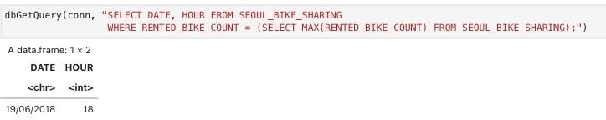
Busiest bike rental times
- The highest number of bike rentals was recorded on June 19, 2018, at 18:00.

Slide 16
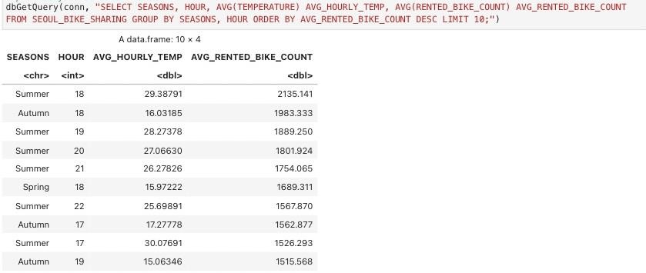
Hourly popularity and temperature by seasons
The top 10 popular hour + season include:
Summer – from 18:00 to 22:00
Autumn – between 17:00 and 19:00
Spring – around 18:00

Slide 17
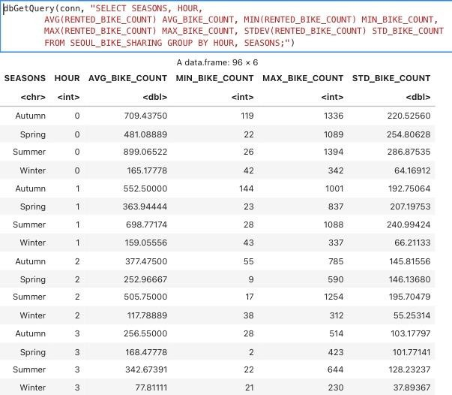
Rental Seasonality

Slide 18
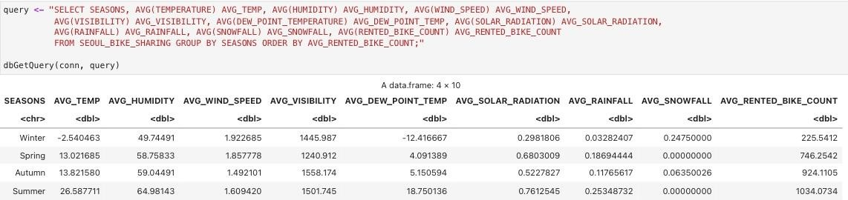
Weather Seasonality
Winter is characterized by the lowest average temperatures and the highest average snowfall, whereas summer exhibits the highest levels of average humidity, solar radiation, and rainfall.
This data suggests a strong correlation between seasonal weather patterns and bike rental trends, evidenced by higher bike rental rates in summer and lower rates in winter.

Slide 19
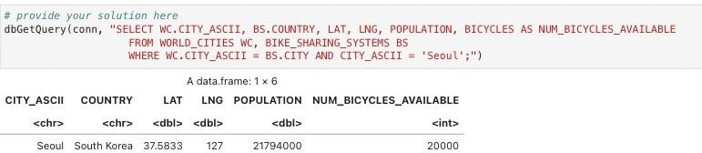
Bike-sharing info in Seoul
Seoul City Info
o Latitude : 37.58, Longitude: 127, Population: 21794000
Number of Bikes Available in Seoul : 20000

Slide 20
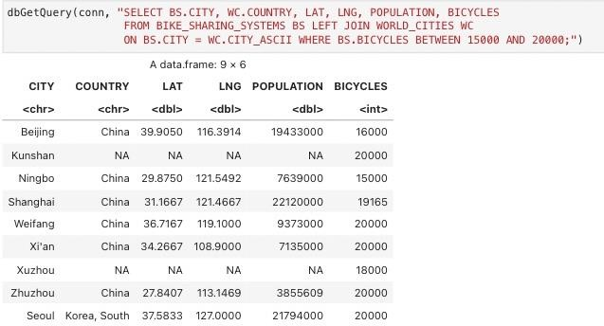
Cities Similar to Seoul
China
o Beijing, Kunshan, Ningbo, Shanghai, Weifang, Xi'an, Xuzhou, Zhuzhou

Slide 21
EDA with Visualization

Slide 22
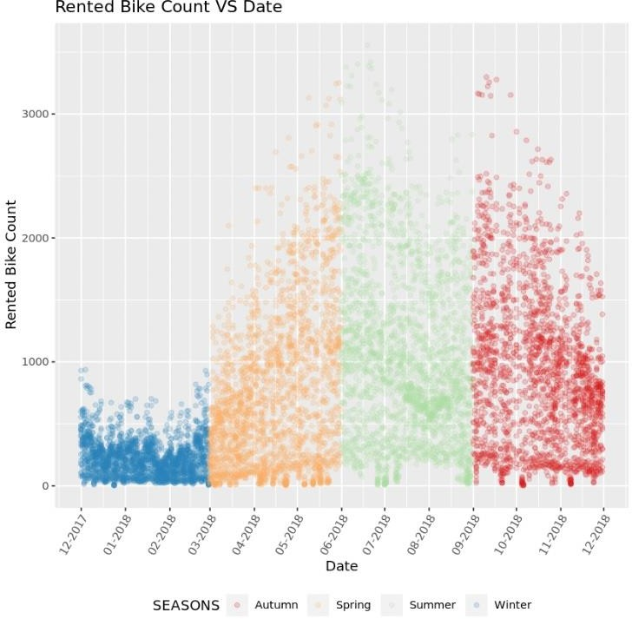
Bike Rental VS Date
Winter -> low bike rental.

Slide 23
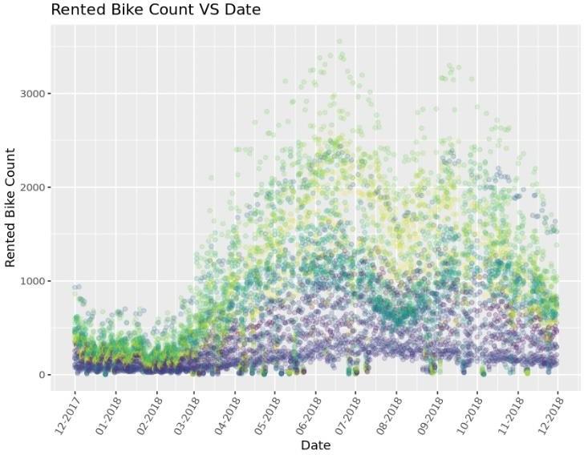
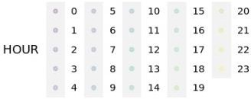
Bike Rental VS Datetime
More bike rentals during evening hours than the early morning period.

Slide 24
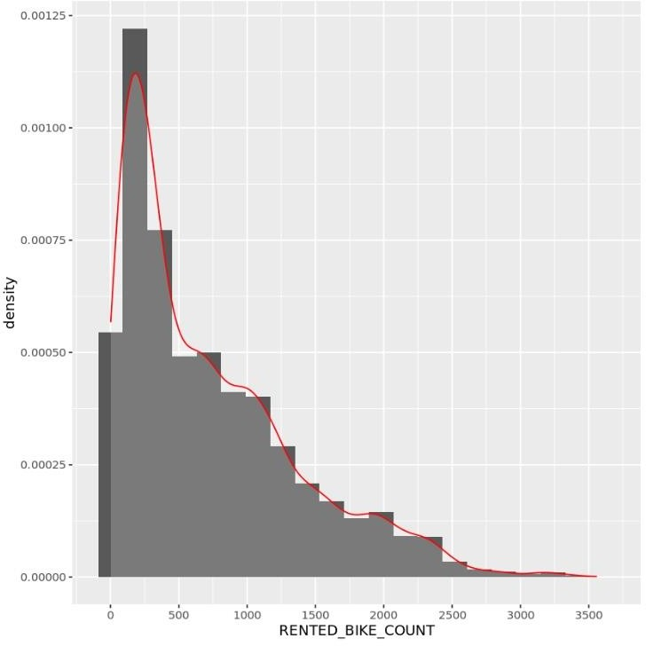
Bike Rental Histogram
Mode: ~ 250
Not normally distributed.
The presence of distinct peaks at around 700, 900, 1900, and 3200 bikes suggests the existence of multiple modes within specific subgroups of the data.
The tail of the distribution indicates that on rare occasions, bike rentals surge significantly above the usual numbers.

Slide 25
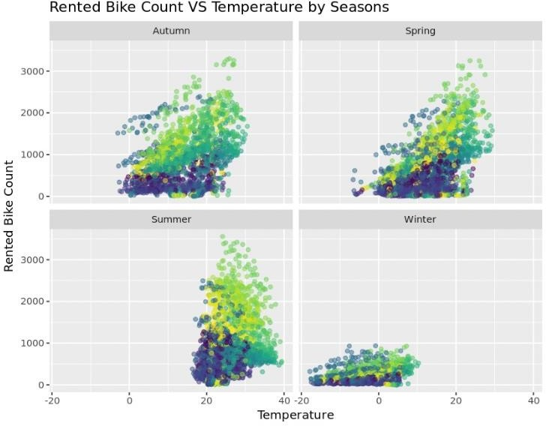
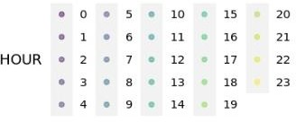
Bike Rental VS Temperature by Seasons
Different seasons have different distributions.
Strong correlations as approximately linear patterns.
Winter has lowest bike rental.
Like we've mentioned earlier, evenings tend to have more bike rental than mornings.

Slide 26
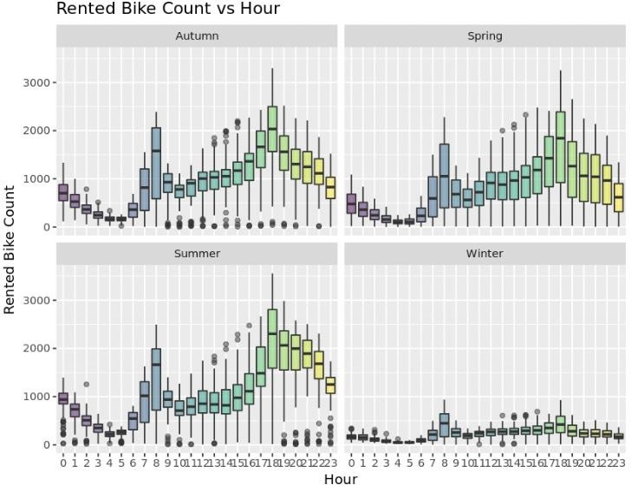
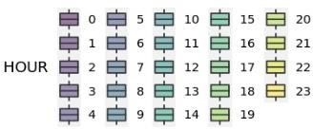
Bike Rental VS Hour by Seasons
The overall scale of bike rental counts changes with the seasons but key features remain similar.
Peak demand times are the same across all seasons, at 8 am and 6 pm.

Slide 27
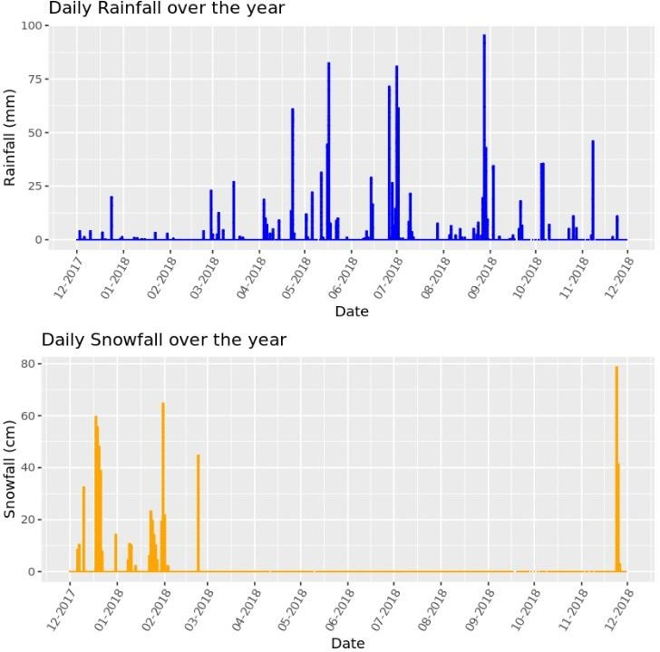
Daily Total Rainfall & Snowfall
The rainy season predominantly spans from mid-April to mid- November, with the most intense rainfall typically occurring in June and July.
Correspondingly, snowfall is primarily observed from December through the end of February.

Slide 28
Predictive analysis

Slide 29
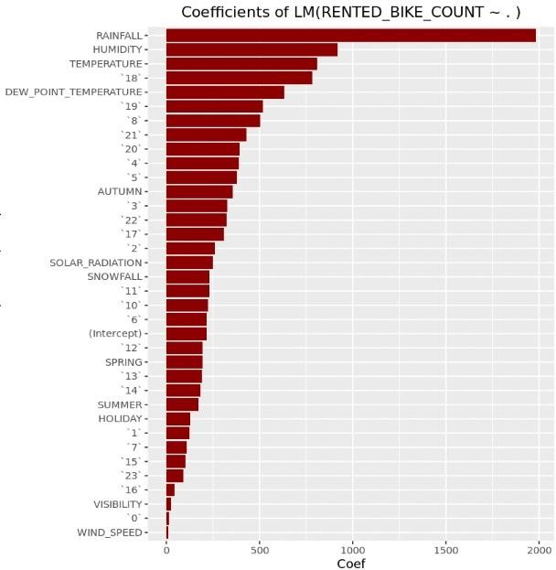
Ranked Coefficients
Analyzing Key Factors in
Bike-Sharing Demand Prediction
Temperature: Warm weather is more conducive to outdoor activities like biking.
Humidity: Discomfort associated with high humidity can make outdoor activities less appealing.
Rainfall: Rainfall has a large negative impact on bike-sharing demand. Nobody wants to cycle in rain.
Time of the Day: Different hours of the day show varying impacts on bike-sharing demand.
The coefficients for 18 – 21 are significantly high, indicating peak hours for bike-sharing, possibly due to people commuting home from work or exercise after work.
Season & Holiday: Seasons & holiday show varying impacts on bike-sharing demand too.
Autumn have the highest positive impact, out of all seasons.
Holidays see a significant decrease in bike-sharing, likely due to regular commuting is reduced.

Slide 30
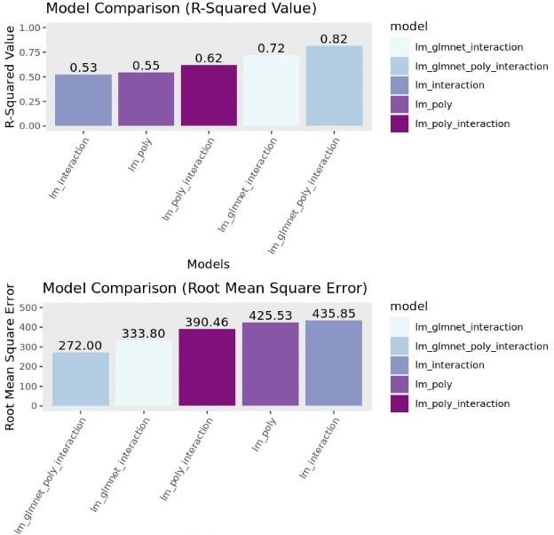
Model Evaluation
We compared 5 models using R-Squared & RMSE values:
linear (polynomial)
linear (interaction)
linear (polynomial + interaction)
glmnet (interaction)
glmnet (polynomial + interaction)
Best Model outperformed the others
significantly
glmnet (polynomial + interaction)
R-Squared Value
o 0.82
RMSE Value
o 272.00

Slide 31
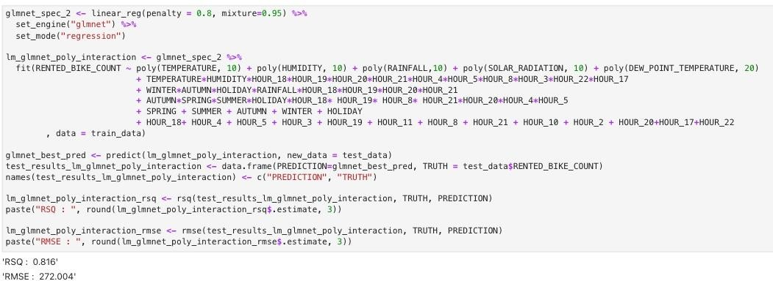
Find the best performing model
R-Squared: 0.816 & RMSE: 272.00

Slide 32
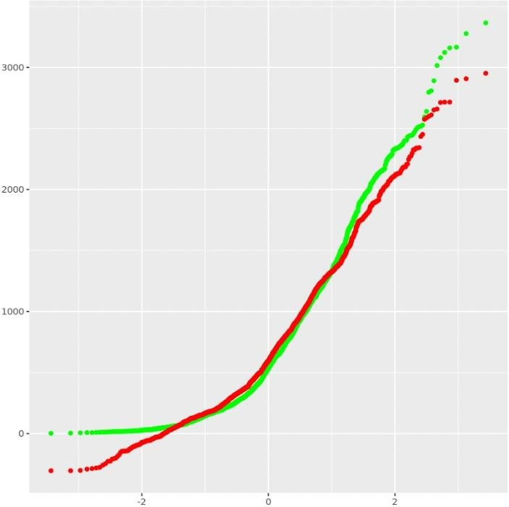
Q-Q plot of the best model
Green = Truths
Red = Predictions

Slide 33
Dashboard

Slide 34
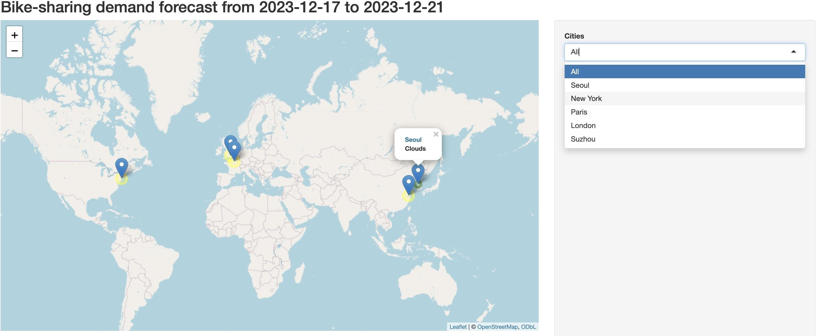
Bike Sharing Demand Forecast UI Overview
This map & drop down menu displays 5 key cities: Seoul, New York, Paris, London, and Suzhou.
It is designed to project the potential for significant bike-sharing demand in these cities over the coming 5 days from 2023-12-17 to 2023-12-21.

Slide 35
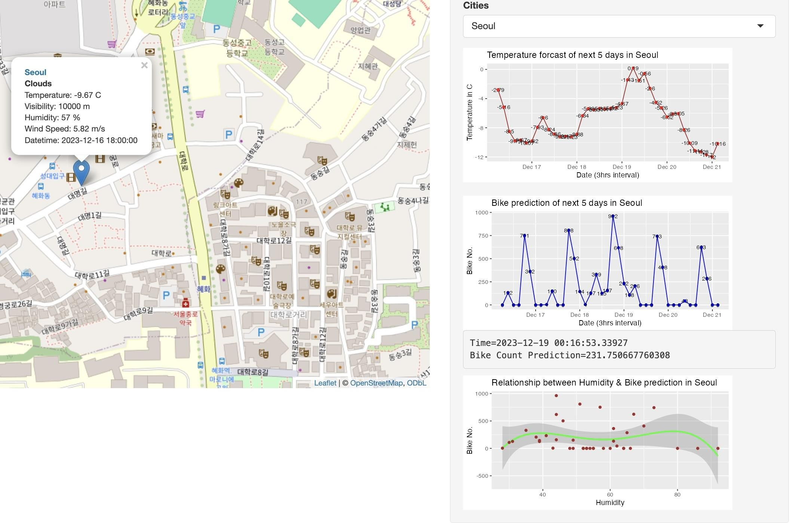
Bike Sharing Forecast in Seoul
On the right, we have
A static temperature trend line
An interactive bike-sharing demand prediction trend line
A static humidity & bike-sharing demand prediction correlation plot

Slide 36
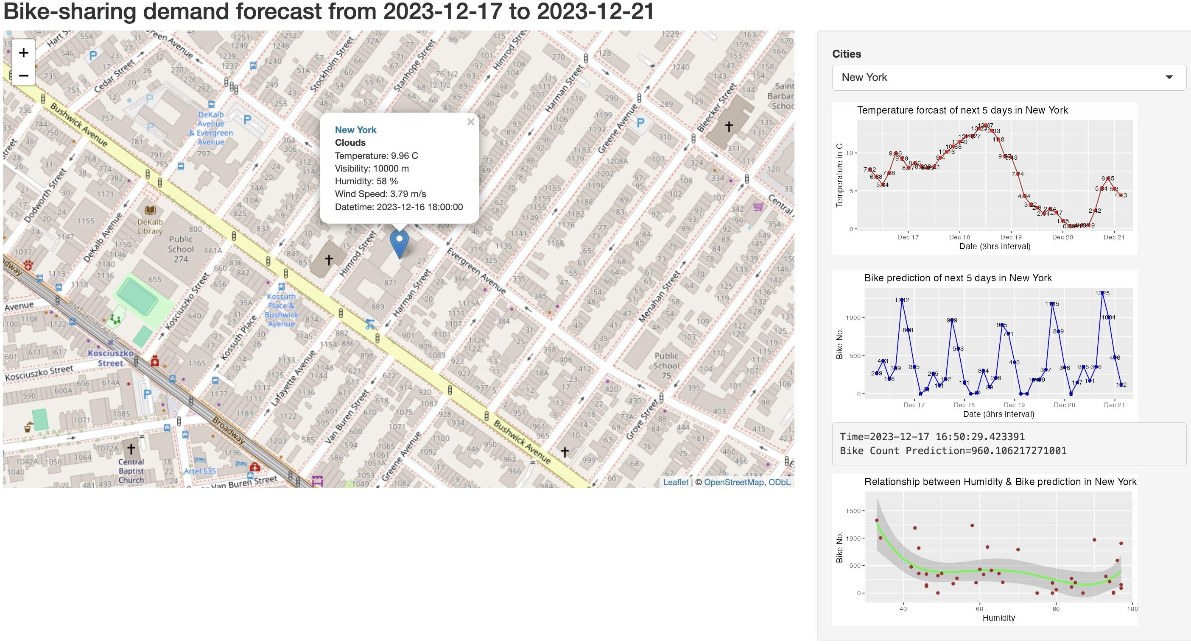
Bike Sharing Forecast in NYC
We include the data scraped from Open Weather API in the marker for each city.
On the right, we included the prediction plots that we've mentioned in previous slide.

Slide 37
CONCLUSION
There is a strong correlation between weather conditions and bike-sharing demand in urban areas, as evidenced by the data from Seoul.
The time of day, particularly in the evening hours from 17:00 to 21:00, and seasonal variations, with summer showing higher demand than winter, significantly impact bike-sharing demand.
Contrary to expectations, bike-sharing demand is lower on holidays compared to non-holidays, suggesting that a considerable portion of bike rentals may be for commuting purposes, such as traveling to work or school.
Inclement weather, especially rainy days, tends to decrease the likelihood of people renting bikes.
Several urban areas in China, including Beijing, Shanghai, Weifang, Ningbo, Xi'an, and Zhuzhou, among others, have a substantial bike-sharing infrastructure, with available fleets ranging from 15,000 to 20,000 bicycles. These cities are ranked according to their population size.

Slide 38
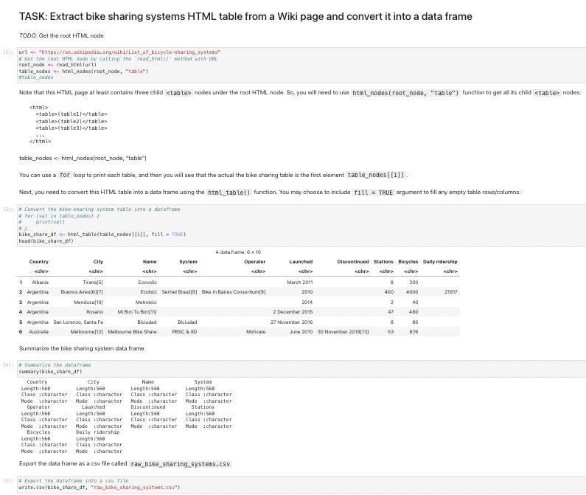
APPENDIX
Web Scrape Global Bike-Sharing Systems Wiki Page

Slide 39
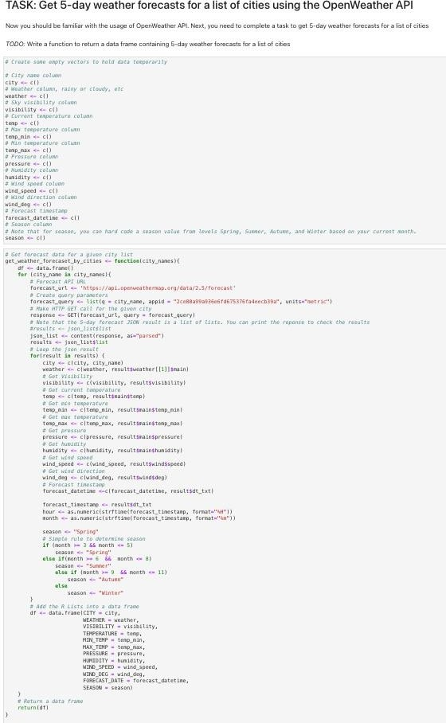
APPENDIX
Open Weather APIs Call

Slide 40
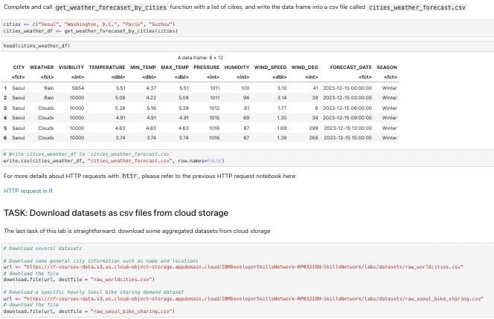
APPENDIX
Open Weather APIs Call

Slide 41
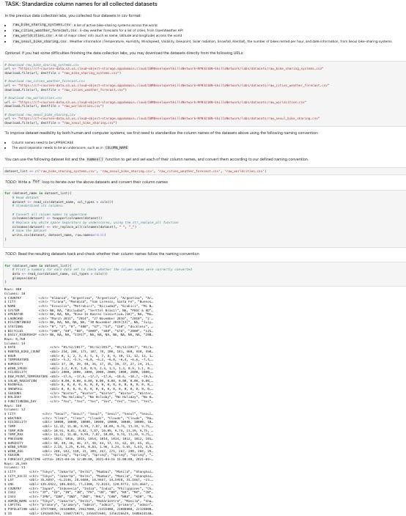
APPENDIX
Data Wrangling with Regular Expressions

Slide 42
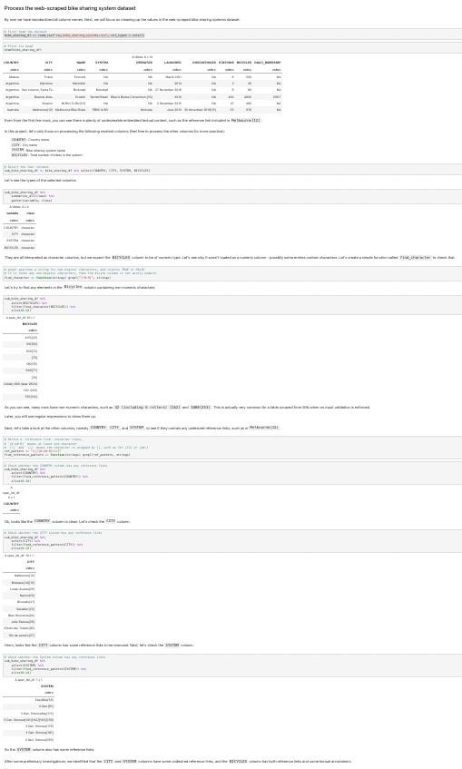
APPENDIX
Data Wrangling with Regular Expressions

Slide 43
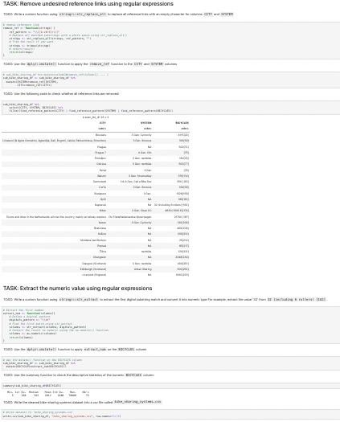
APPENDIX
Data Wrangling with Regular Expressions

Slide 44
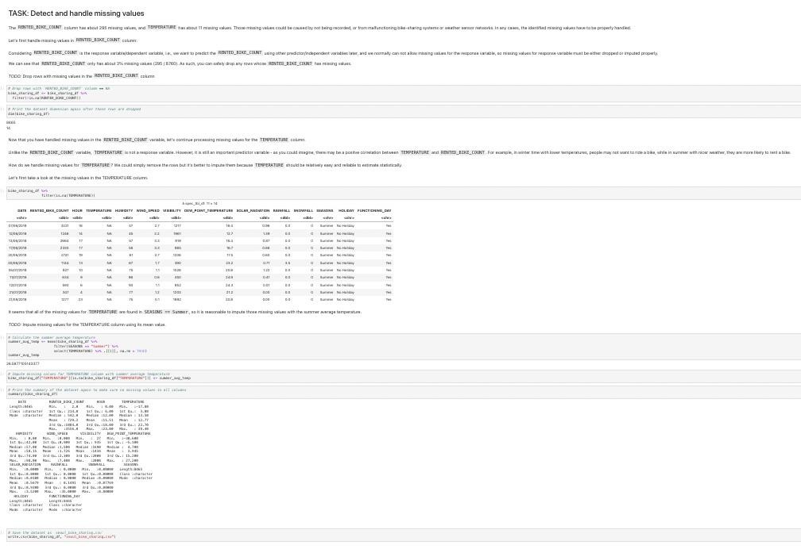
APPENDIX
Data Wrangling with dplyr

Slide 45
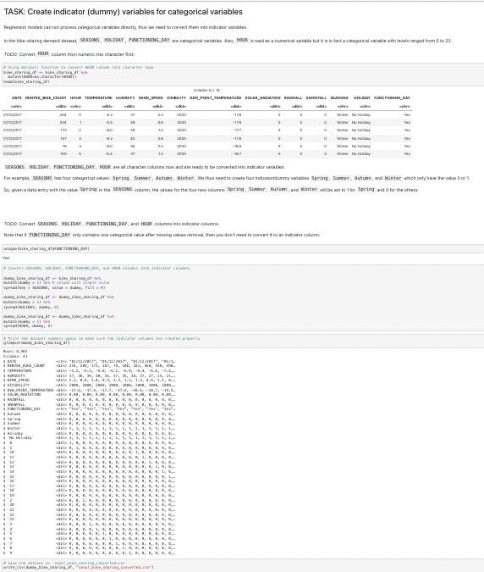
APPENDIX
Data Wrangling with dplyr

Slide 46
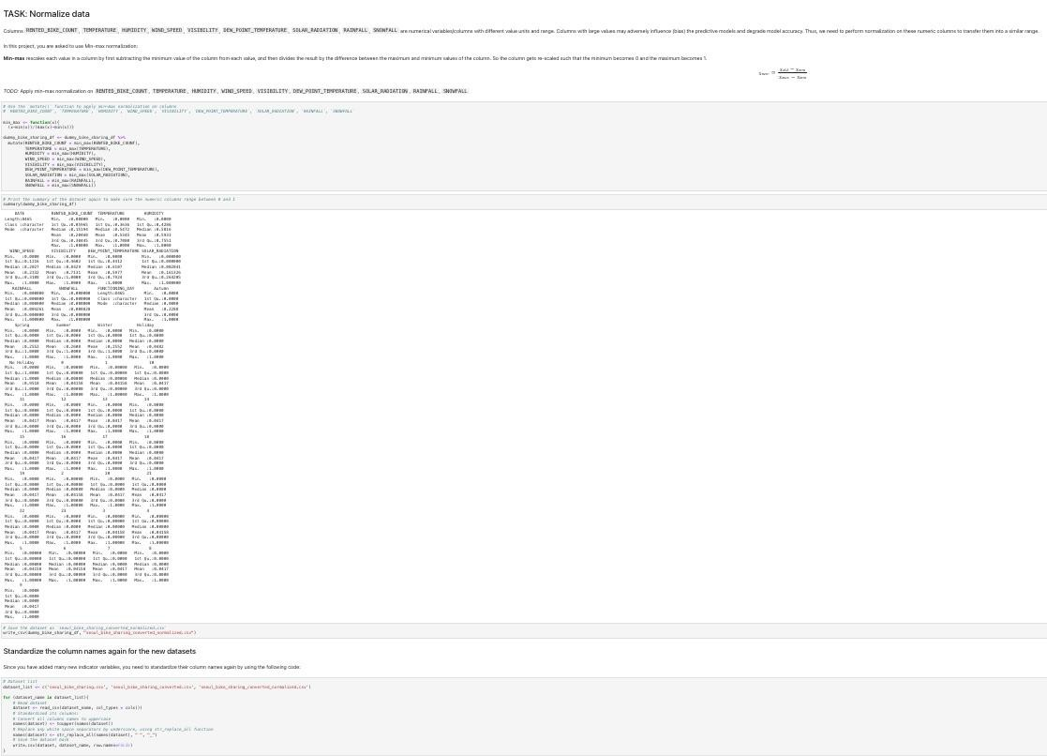
APPENDIX
Data Wrangling with dplyr

Slide 47
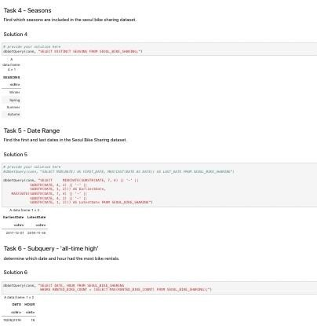
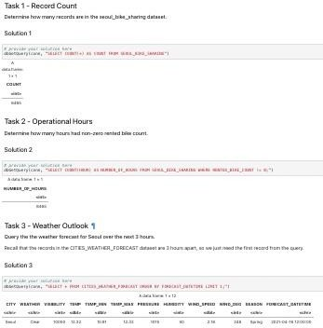
APPENDIX
EDA with SQL

Slide 48
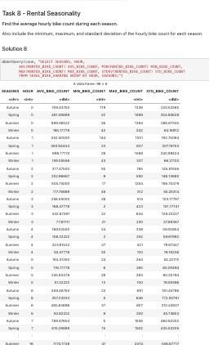
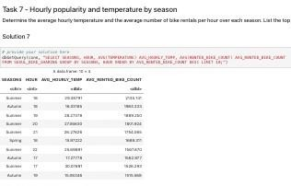
APPENDIX
EDA with SQL

Slide 49
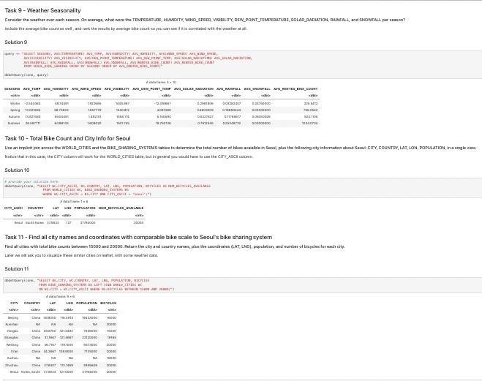
APPENDIX
EDA with SQL

Slide 50
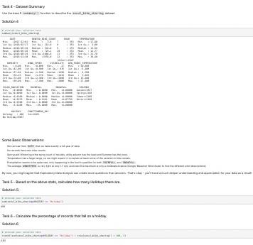
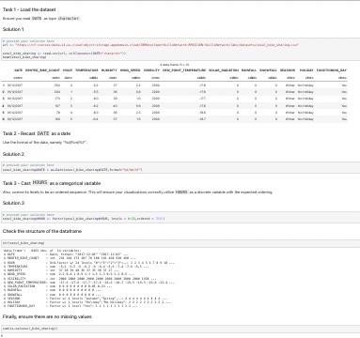
APPENDIX
EDA with tidyverse & ggplot2

Slide 51
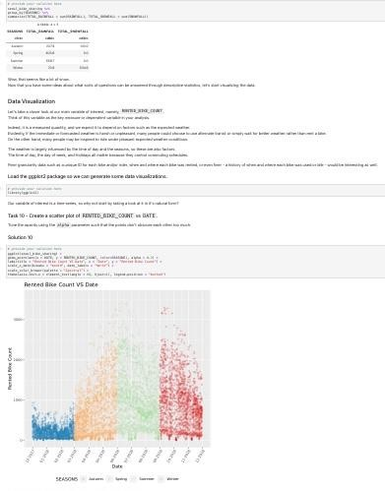
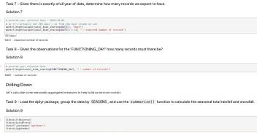
APPENDIX
EDA with tidyverse & ggplot2

Slide 52
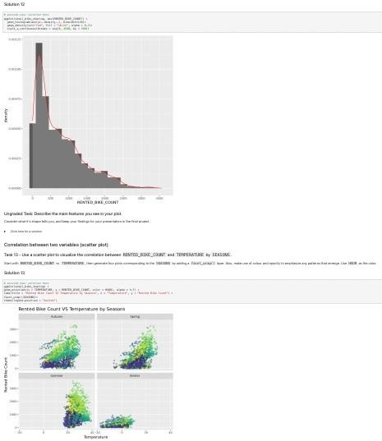
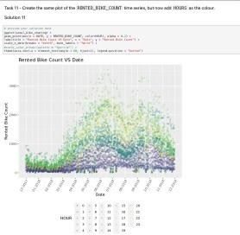
APPENDIX
EDA with tidyverse & ggplot2

Slide 53
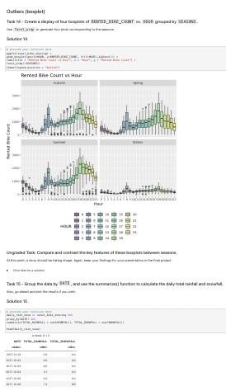
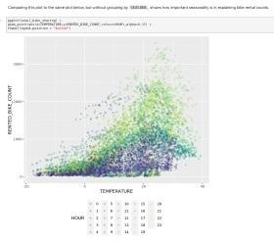
APPENDIX
EDA with tidyverse & ggplot2

Slide 54
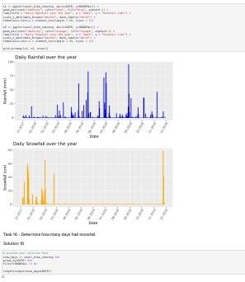
APPENDIX
EDA with tidyverse & ggplot2

Slide 55
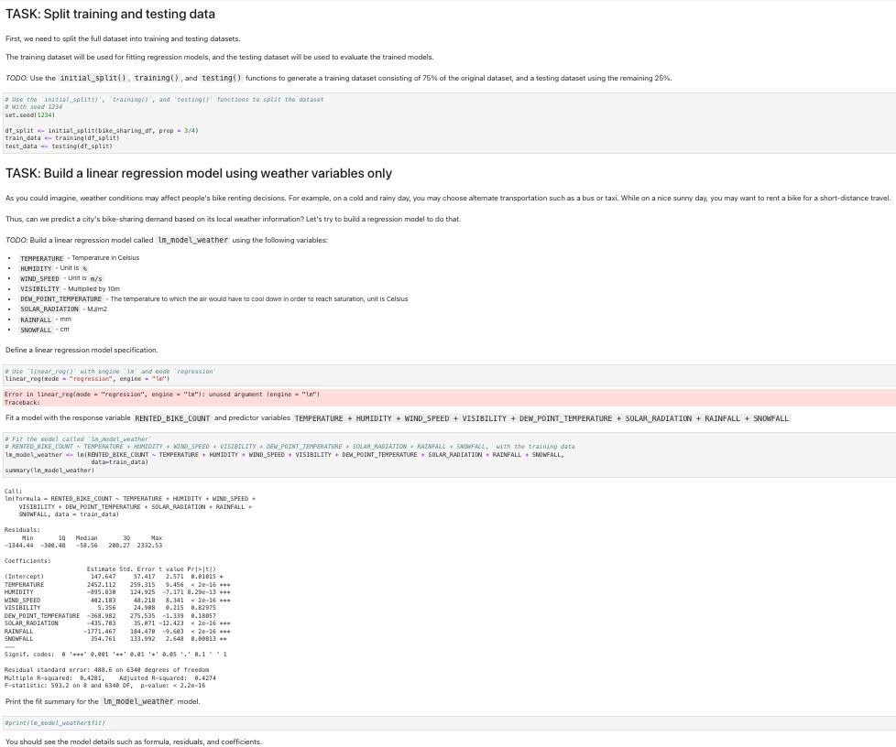
APPENDIX
Linear Models Baseline

Slide 56
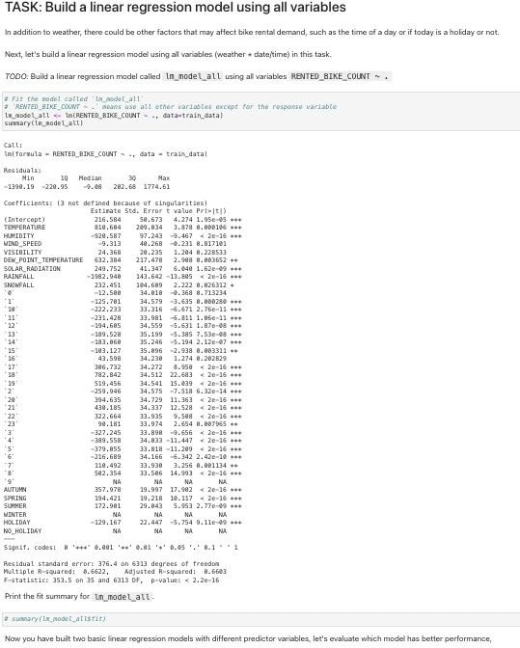
APPENDIX
Linear Models Baseline

Slide 57
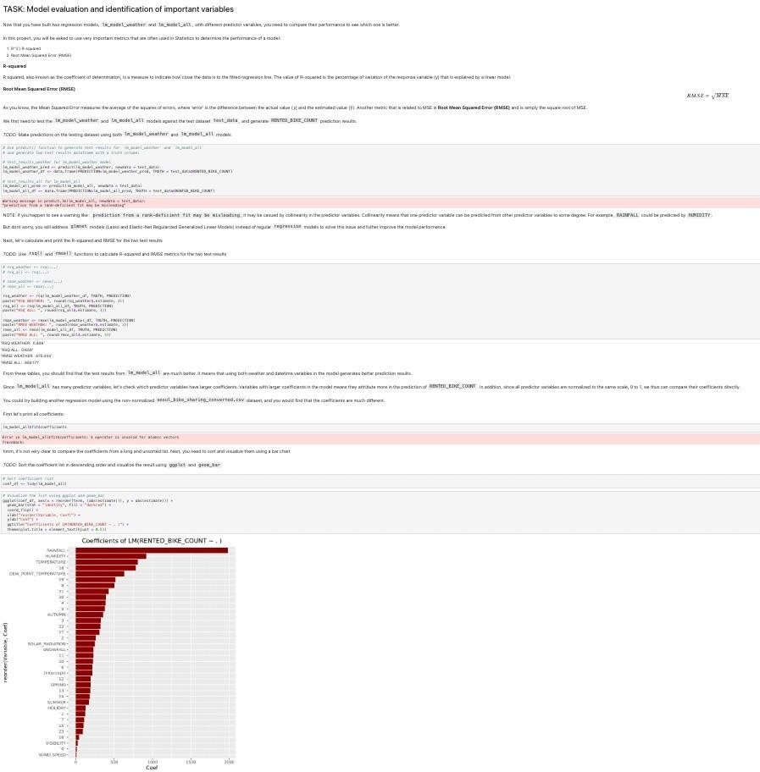
APPENDIX
Linear Models Baseline

Slide 58
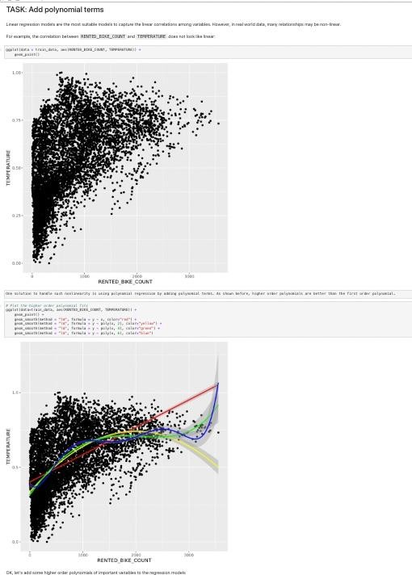
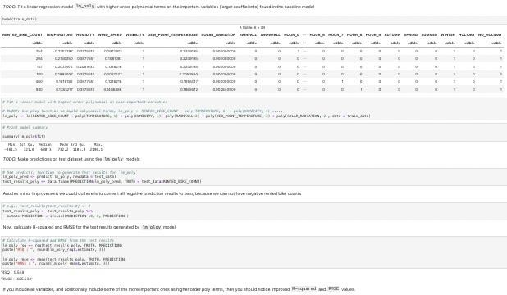
APPENDIX
Refine Baseline Regression Models

Slide 59


APPENDIX
Refine Baseline Regression Models

Slide 60


APPENDIX
Refine Baseline
Regression Models

Slide 61

APPENDIX
Refine Baseline
Regression Models

Slide 62



APPENDIX
Refine Baseline
Regression Models
6
2

Slide 63

APPENDIX
Refine Baseline
Regression Models

Slide 64

APPENDIX
Build
R Shiny Dashboard [ui.R]

Slide 65

APPENDIX
Build
R Shiny Dashboard
[model_prediction.R]

Slide 66

APPENDIX
Build
R Shiny Dashboard
[model_prediction.R]

